Slide 1
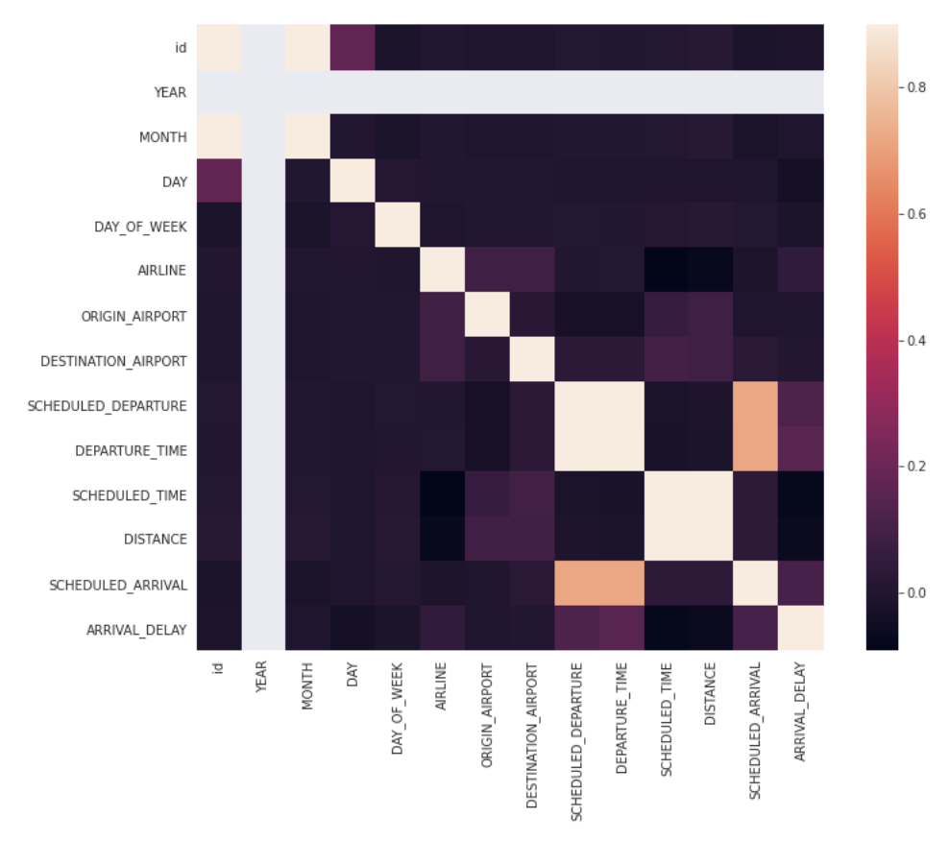
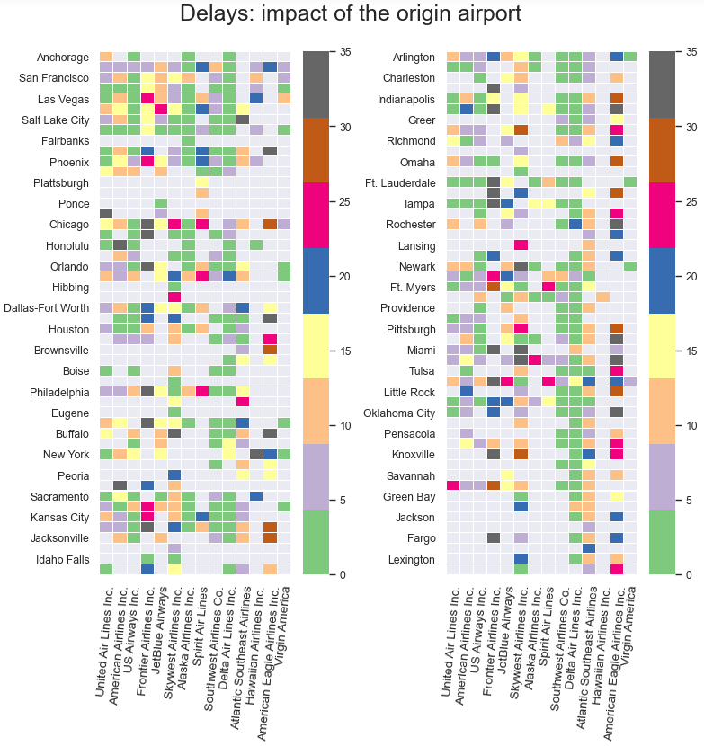
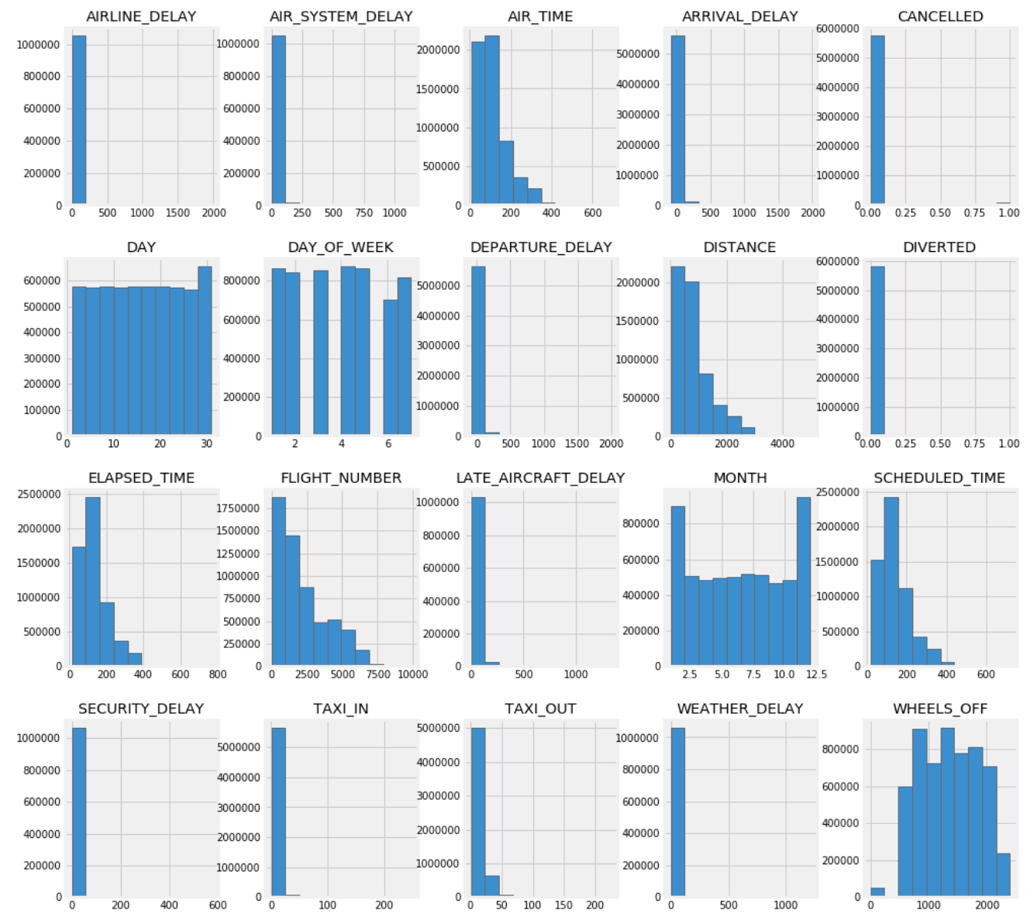
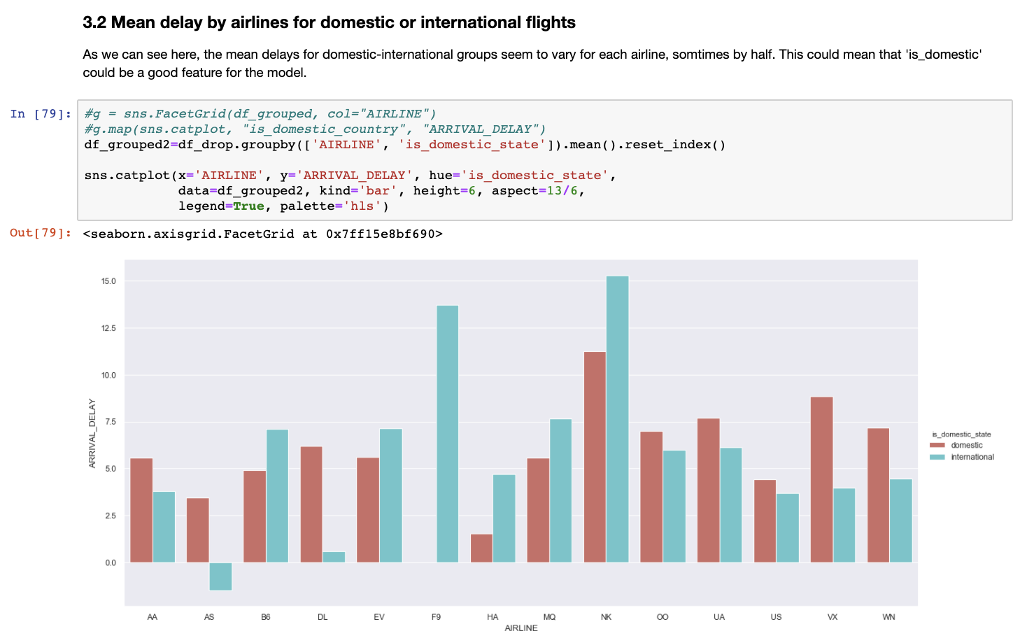
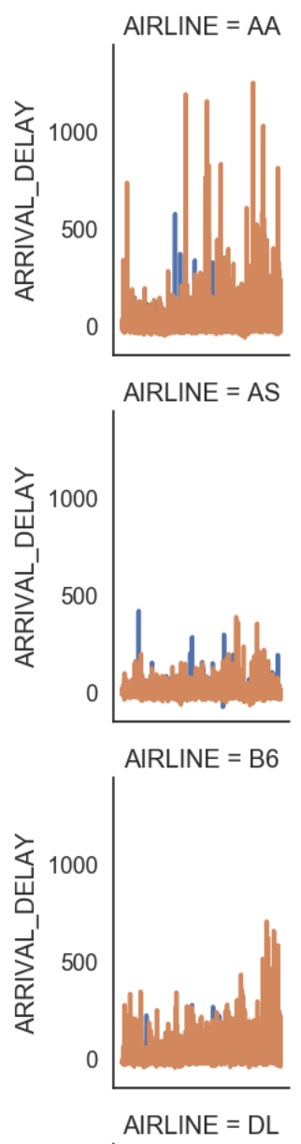
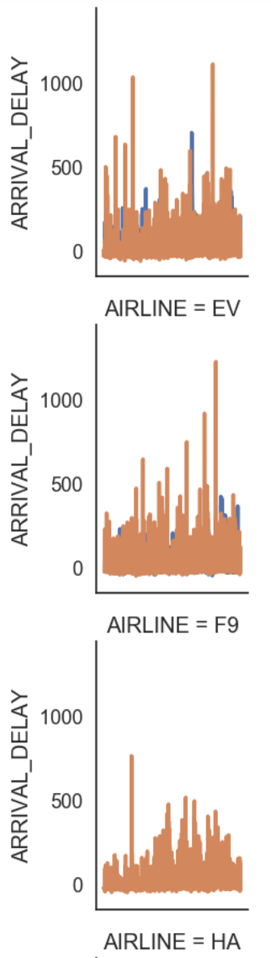
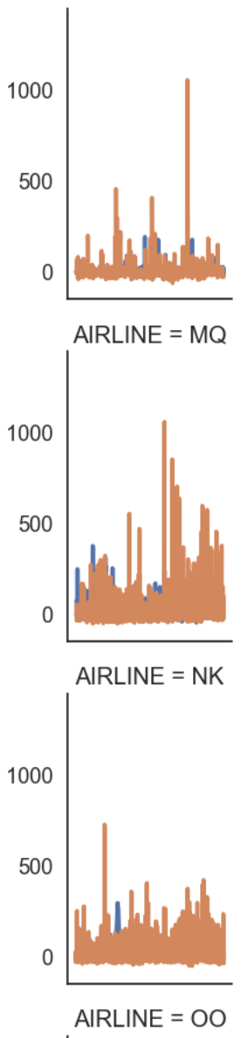
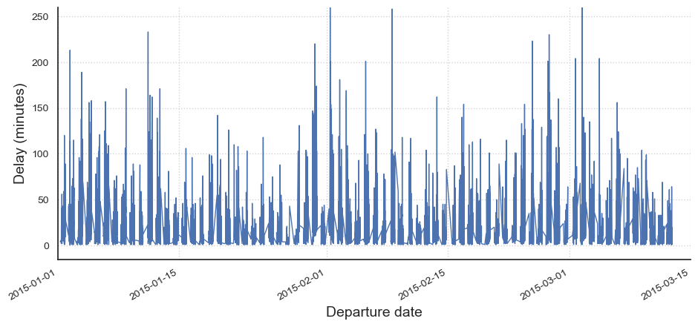
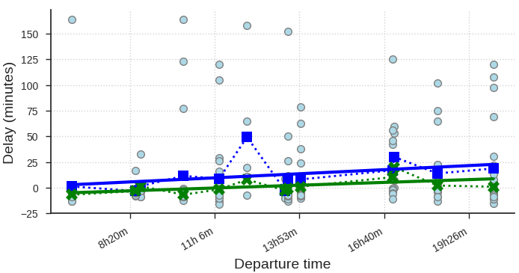
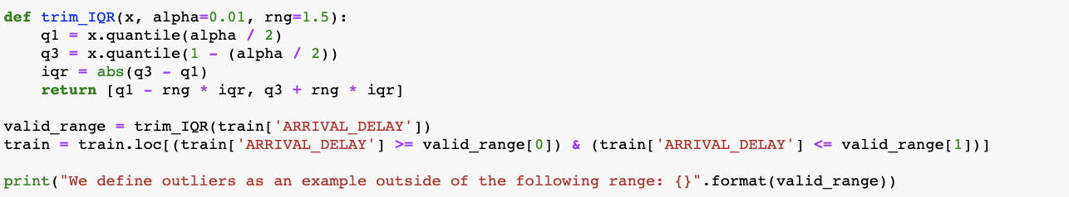
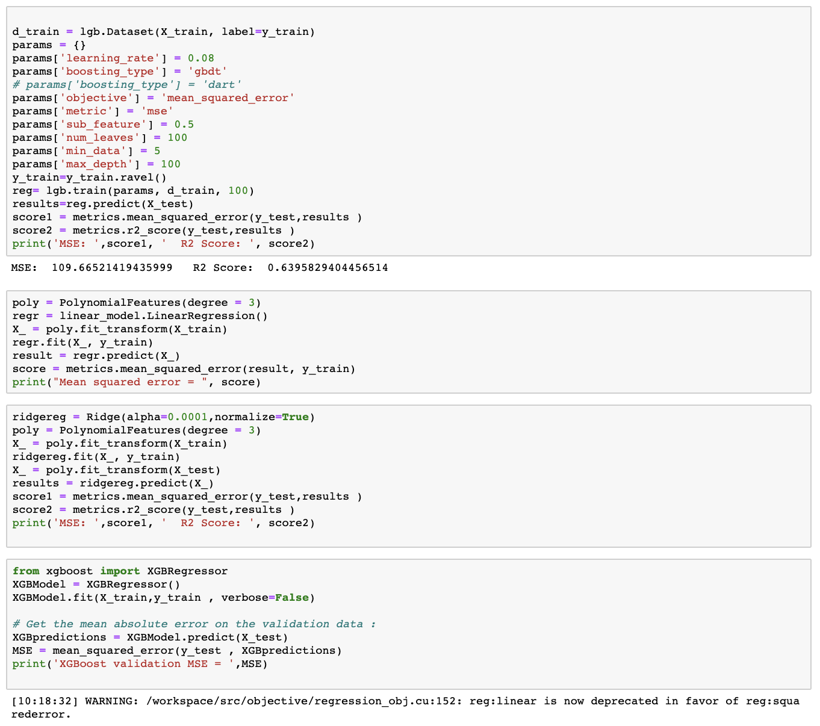
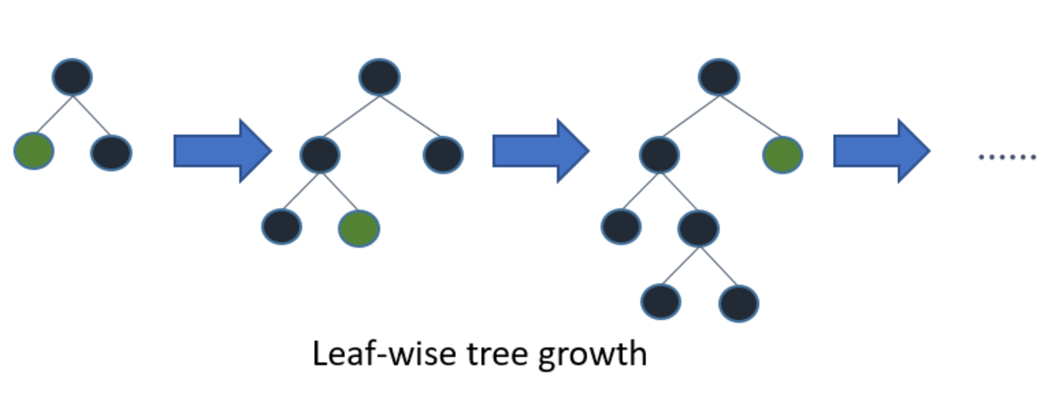
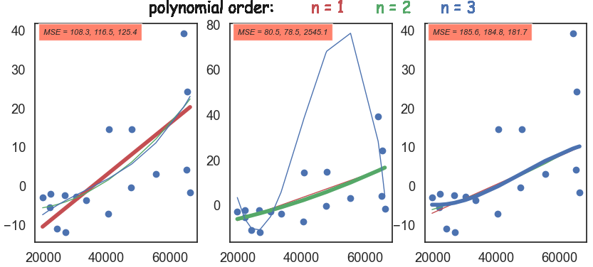
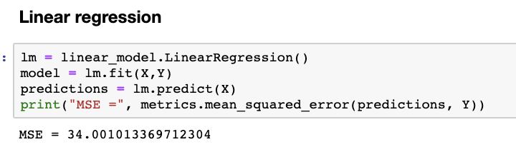
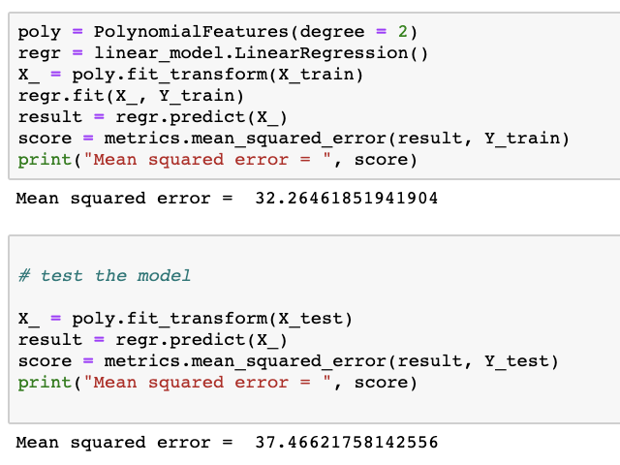
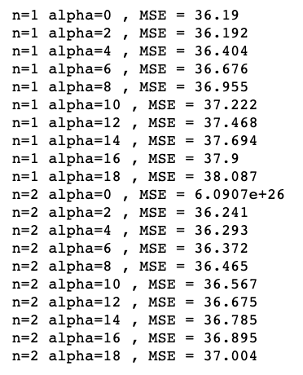
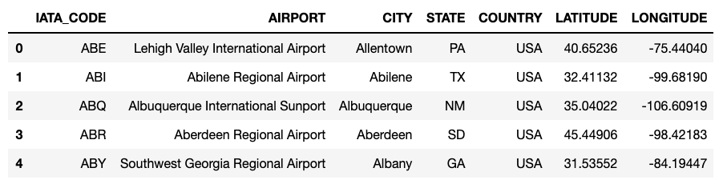
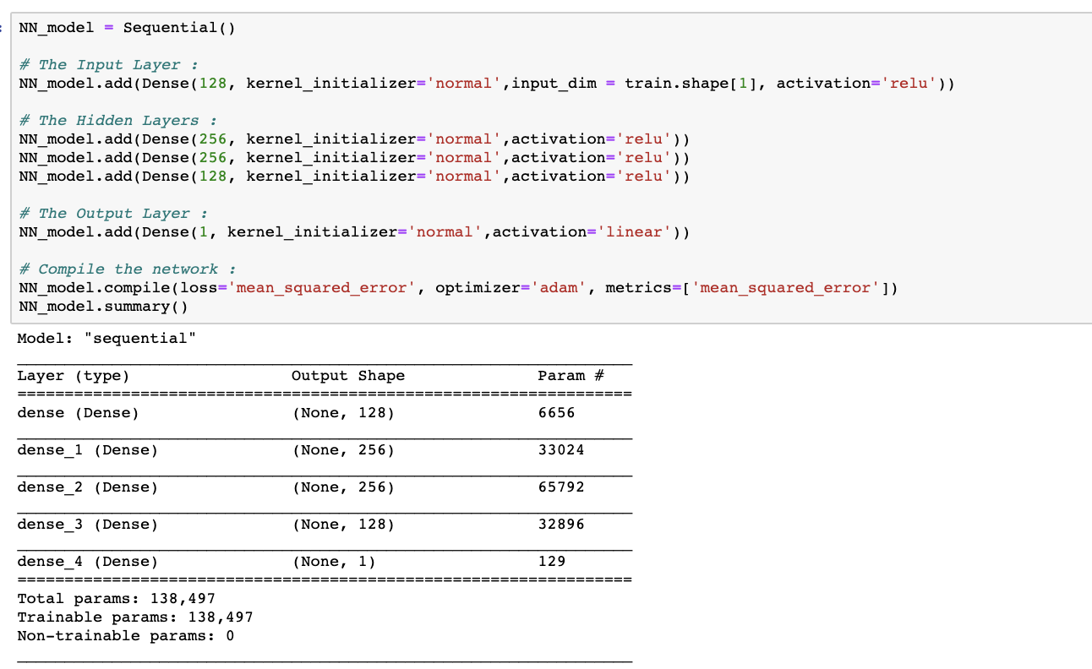
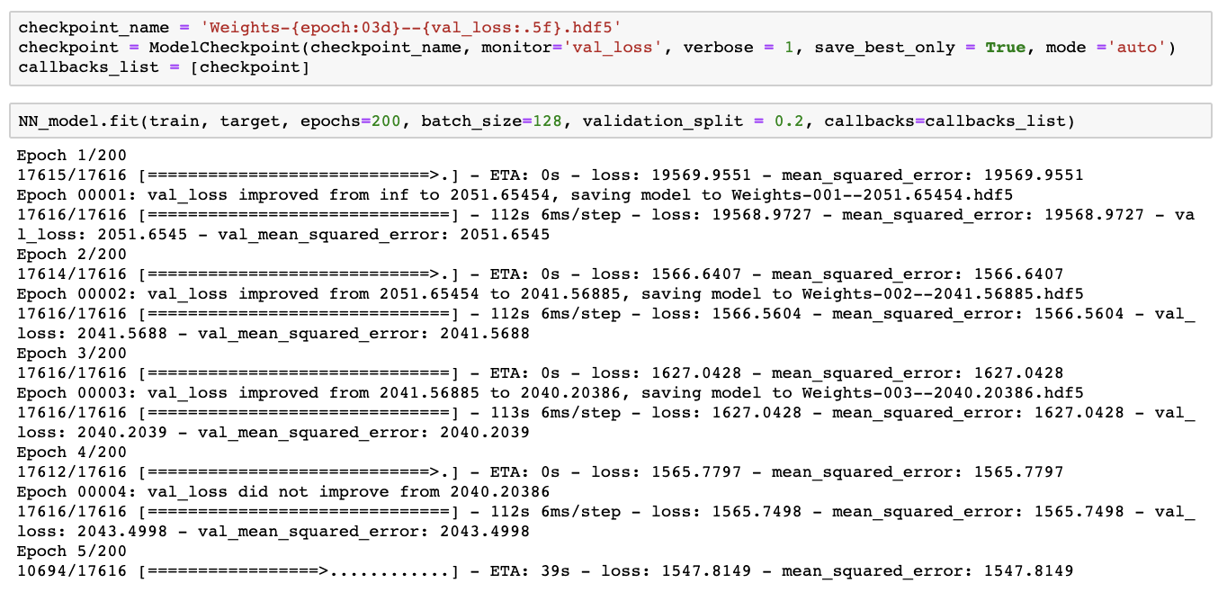
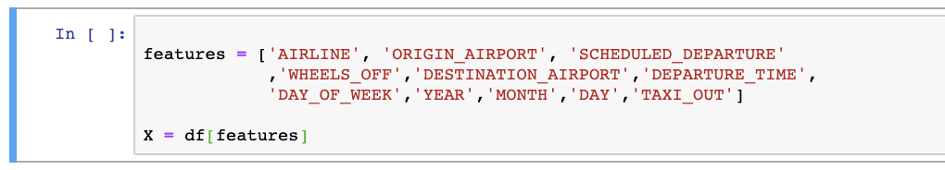
FLIGHT DELAY PREDICTION
Introduction
2015 US flight delays dataset includes information about flight delays. This project aims to predict the flight delays.
Methodology
Data Exploration
Data Preparation
Feature Engineering
Algorithm evaluations
Final model - NN
Results Evaluation
Challenges/Improvement
Conclusion
Data exploration
Airports data
5 columns, 3 of which are about geo information of airports and one the naming of the airport ID
Mainly categorical variables, numerical location (long-lat) can also be transformed to categorical.
Flights data
15 columns, mainly temporal, numerical variables
Contains airport, airline, travel information + scheduled arrival-departure and actual arrival-departure time
Temporal data needs to be formatted
Data preparation
Remove NaN and invalid values
Remove non-useful variables: ['FLIGHT_NUMBER', 'TAIL_NUMBER']
Transform variables (arrival-departure time)
Remove outliers from ARRIVAL_DELAY variable using IQR:
Leave only variables to be used in modelling
One-Hot encoding (categorical values for the model)
Feature engineering
Data distributions
Delay difference for DOMESTIC-INTERNATIONAL travel using origin and
arrival state columns
Temporal variability in delays (Airport, Airline, Departure Time and date)
Correlations
Key features
Departure time
….
….
Modelling - Algorithm evaluations
Initial try of models
Fit the linear regression and polynomial model
Fit the model on train and test data
Obtained final MSE of 40 for the test set
Modelling – Hyperparameter tuning
Pipelines (run preprocessing, avoid leaking training data)
StandardScaler (multivariate data mean = 0 standard deviation = 1)
RandomizedSearchCV (Help narrow down hyperparameters)
GridSearchCV (help optimise hyperparameter combinations)
Final model - NN
After struggling with regression and LGB we finally stoppedwith NN model.
Our methodology for NN [Dat and Shavin can you elaborate here]:
Smth
Smth
smth
Results and discussion
After using several model we finally stopped on Neural Networks model. It had a pretty stable performance and the least problems during testing and training. [Can you guys discuss the results here]
Challenges
Despite our tutorial practice and model prediction and MSE on train set was good enough, there were some challenges on model prediction for train set. Main problems we had:
Computational power
Poor MSE score for LGB, which was hard to improve
Issues with implementing linear regression
Difficulty improving the overall MSE score, also for NN model
Conclusion
At the end, we learned that for each model prediction there are always production issues that are not always straightforward to solve. We learned that:
We need to try several models, even we think model performance is good enough
Never give up on problems and push hard to solve them
Pay attention to data exploration
Good feature engineering and model choice is a key
References
[1] What is LightGBM, How to implement it? How to fine tune the parameters? From: https://medium.com
Light Gradient Boosting (LGB) | Ridge Regression
MSE: 109.66 | MSE: 177

Slide 2
Flight delay prediction
Introduction
2015 US flight delays dataset includes information about flight delays. This project aims to predict the flight delays.
Methodology
Data Exploration
Data Preparation
Feature Engineering
Algorithm evaluations
Final model - NN
Results Evaluation
Challenges/Improvement
Conclusion
Data exploration
Airports data
5 columns, 3 of which are about geo information of airports and one the naming of the airport ID
Mainly categorical variables, numerical location (long-lat) can also be transformed to categorical.
Flights data
15 columns, mainly temporal, numerical variables
Contains airport, airline, travel information + scheduled arrival-departure and actual arrival-departure time
Temporal data needs to be formatted
Data preparation
Remove NaN and invalid values
Remove outliers and missing values
Remove non-useful variables: ['FLIGHT_NUMBER', 'TAIL_NUMBER']
Transform variables (arrival-departure time)
Remove outliers from ARRIVAL_DELAY variable using IQR:
Leave only variables to be used in modelling
One-Hot encoding (categorical values for the model)
Feature engineering
We used Kaggle tutorial for a good start of and understanding of the data and model. We did data exploration, preparation and modelling with the tutorial data and obtained interesting results. We:
looked at the data distribution
made data exploration and preparation
looked at delay difference for DOMESTIC-INTERNATIONAL travel using origin and arrival state columns
Temporal variability in results
Initial try of models
Fit the linear regression and polynomial model
Fit the model on train and test data
Obtained final MSE of 40 for the test set
Algorithm evaluations
Ridge Regression
Light Grade Boosting (LGB)
LGB the algorithm of which uses tree based learning [1], polynomial regression and Neural Networks.
Final model - NN
After struggling with regression and LGB we finally stoppedwith NN model.
Our methodology for NN [Dat and Shavin can you elaborate here]:
Smth
Smth
smth
Results and discussion
After using several model we finally stopped on Neural Networks model. It had a pretty stable performance and the least problems during testing and training. [Can you guys discuss the results here]
Challenges
Despite our tutorial practice and model prediction and MSE on train set was good enough, there were some challenges on model prediction for train set. Main problems we had:
Poor MSE score for LGB, which was hard to improve
Issues with implementing linear regression
Difficulty improving the overall MSE score, also for NN model
Conclusion
At the end, we learned that for each model prediction there are always production issues that are not always straightforward to solve. We learned that:
We need to try several models, even we think model performance is good enough
Never give up on problems and push hard to solve them
Pay attention to data exploration
Good feature engineering and model choice is a key
References
[1] What is LightGBM, How to implement it? How to fine tune the parameters? From: https://medium.com

Slide 3
Introduction
Methodology
Data Exploration
Data Preparation
Feature Engineering
Trial Models
Final model - NN
Results Evaluation
Challenges/Improvement
Conclusion

